Slide 1
Gene Expression
Explore Gene Expression in scRNA datasets DDS

Slide 2
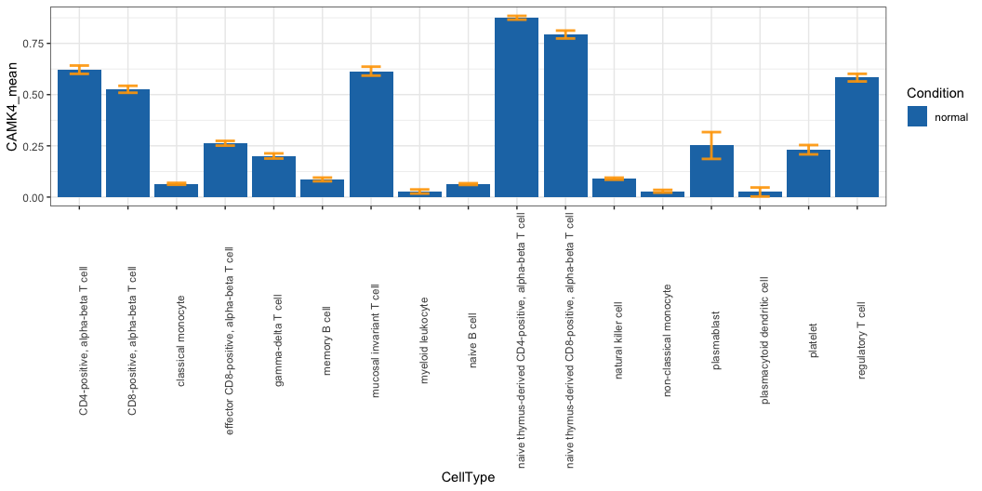
gene Expression distribution in PBMC(PMID35383111)

Slide 3
CAMK4 expression is enhanced in naïve/memory/effector T cells.
Learn more: talk2data

Slide 4
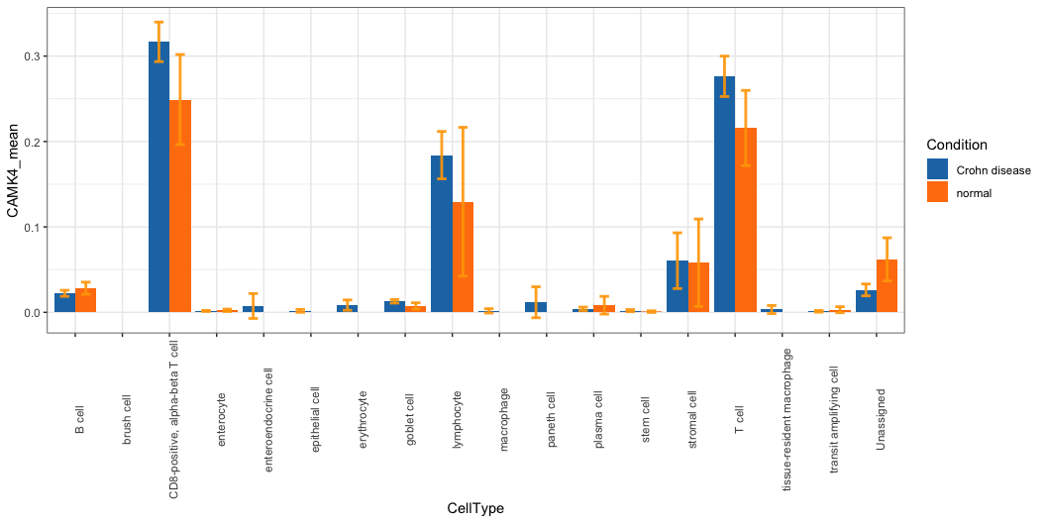
Expression distribution of CAMK4 in cells of the human intestinal tract (PMID34497389)

Slide 5
CAMK4 expression is enhanced in

Slide 6
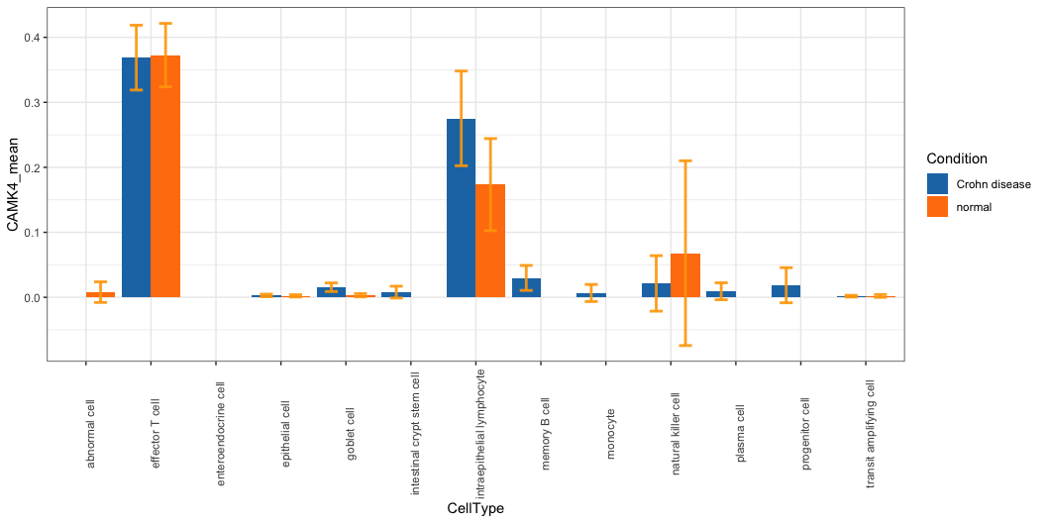
Expression distribution of CAMK4 in IBD patient samples
GSE164985/colonic mucosa

Slide 7
CAMK4 expression is enhanced in

Slide 8
THANK YOU!!

